Slide 1
EQUIPMENT’S CLASSROOM MANAGEMENT
Group 10:
Trần Vĩnh Quang – SE61078
Tăng Việt Hưng – SE61019
Đoàn Nguyễn Minh Chí – SE60717
Supervisor:
Kiều Trọng Khánh

Slide 2
OUTLINE
Current Situation
Solution
Demonstration
Advantages and Disadvantages
Future plan
Question and Answers

Slide 3


CURRENT SITUATION
Staff

Slide 4

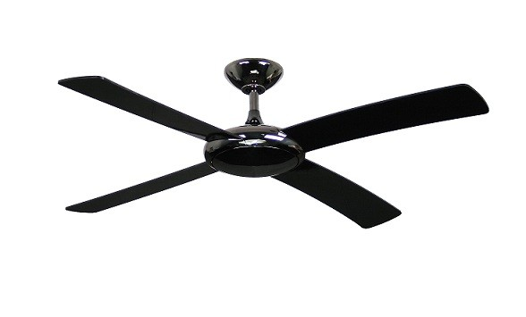
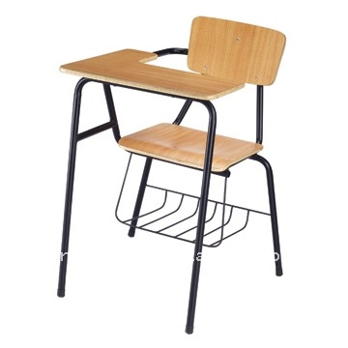
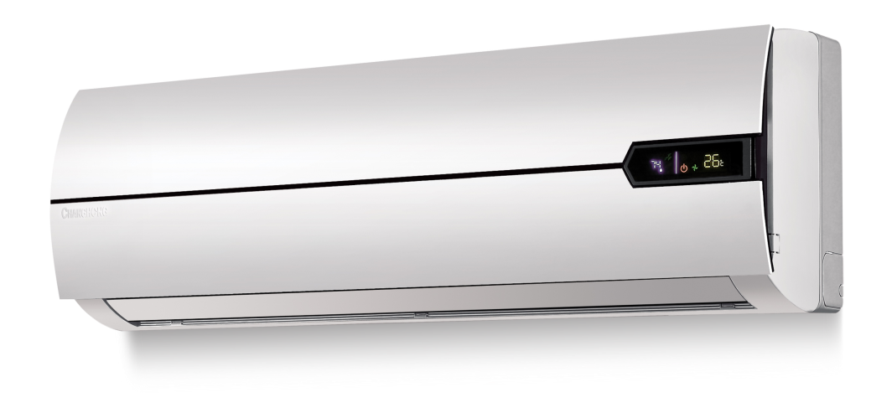
CURRENT SITUATION

Slide 5
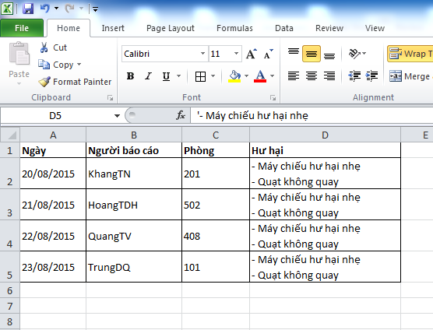
CURRENT SITUATION

Slide 6


CURRENT SITUATION

Slide 7
CURRENT SITUATION

Slide 8
CURRENT SITUATION

Slide 9

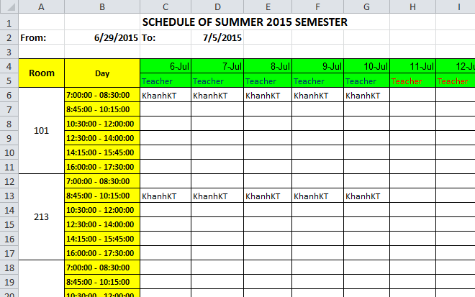
CURRENT SITUATION

Slide 10
CURRENT SITUATION

Slide 11
CURRENT SITUATION

Slide 12
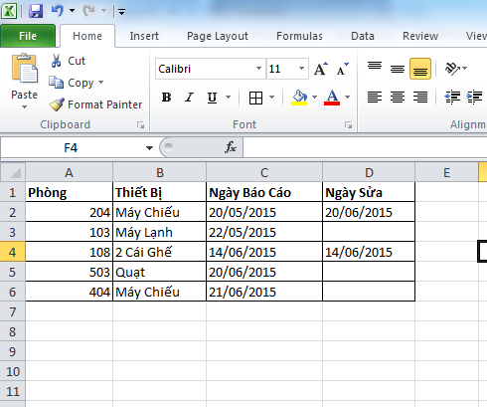

CURRENT SITUATION

Slide 13
CURRENT SITUATION
1
Managing equipment is manual
2
Waste time when receive and resolve report
3
Hard to notice when needed
4
Require human resource

Slide 14
SOLUTION
ECRM
Teacher

Slide 15
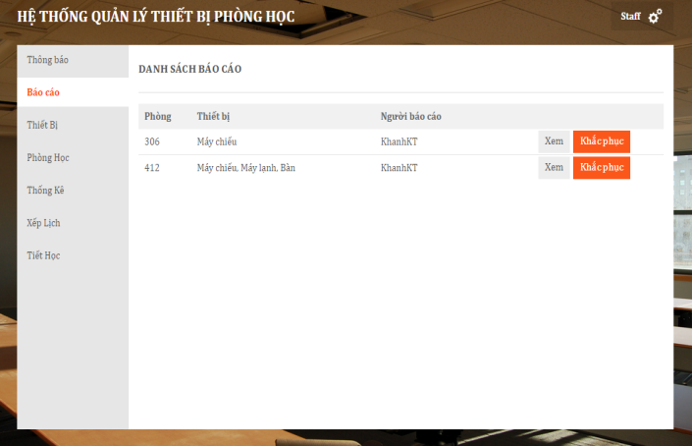
SOLUTION
ECRM

Slide 16
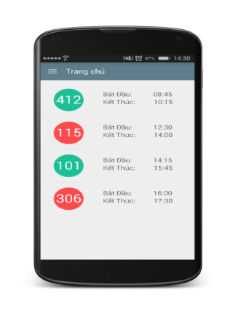
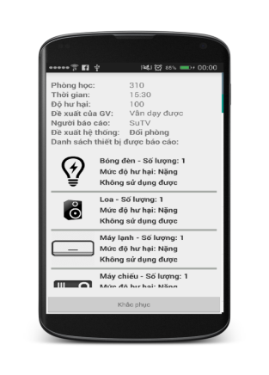
SOLUTION
ECRM

Slide 17
SOLUTION
ECRM

Slide 18
SOLUTION
Managing equipment is automatic
ECRM

Slide 19
SOLUTION
Managing equipment is automatic
Automatically receive and analyze data report
ECRM

Slide 20
SOLUTION
Managing equipment is automatic
Automatically receive and analyze data report
ECRM
Notice based on SMS and notification in real time

Slide 21
SOLUTION
Managing equipment is automatic
Automatic receive and analyze data report
ECRM
Notice based on SMS and notification in real time
Require less human resource

Slide 22
CLASSROOM
CLASSROOM OBJECT
ClassName
NumberSlot

Slide 23
CLASSROOM
CLASSROOM OBJECT
ClassName
NumberSlot
EQUIPMENT CATEGORY OBJECT
ClassName
Name
0.. *

Slide 24
CLASSROOM
CLASSROOM OBJECT
ClassName
NumberSlot
EQUIPMENT CATEGORY OBJECT
ClassName
Name
0.. *
0.. *

Slide 25
CLASSROOM
ROOMTYPE OBJECT
CLASSROOM OBJECT
ClassName
NumberSlot
EQUIPMENT CATEGORY OBJECT
Name

Slide 26
CLASSROOM
ROOMTYPE OBJECT
RoomTypeId
0..1
CLASSROOM OBJECT
ClassName
NumberSlot
RoomTypeId
EQUIPMENT CATEGORY OBJECT
Name
0..*

Slide 27
CLASSROOM
ROOMTYPE OBJECT
RoomTypeId
0..1
0..*
CLASSROOM OBJECT
ClassName
NumberSlot
RoomTypeId
EQUIPMENT CATEGORY OBJECT
Name
1..*
0..*

Slide 28
CLASSROOM
ROOMTYPE OBJECT
RoomTypeId
0..1
0..*
CLASSROOM OBJECT
ClassName
NumberSlot
RoomTypeId
EQUIPMENT CATEGORY OBJECT
Name
1..*
0..*

Slide 29
CLASSROOM
EQUIPMENT QUANTITY OBJECT
RoomTypeID
EquipmentName
Quantity
Priority
0..*
0..*
EQUIPMENT CATEGORY OBJECT
Name
ROOMTYPE OBJECT
RoomTypeID
1..1
1..1

Slide 30
CLASSROOM
CLASSROOM OBJECT
ClassName
NumberSlot
RoomTypeID

Slide 31
CLASSROOM
CLASSROOM OBJECT
ClassName
NumberSlot
RoomTypeID
ROOMTYPE OBJECT
RoomTypeID
0..*
1..1

Slide 32
CLASSROOM
CLASSROOM OBJECT
ClassName
NumberSlot
RoomTypeID
ROOMTYPE OBJECT
RoomTypeID
0..*
1..1
1..1
0..*
EQUIPMENT QUANTITY OBJECT
RoomTypeID
EquipmentName
Quantity
Priority

Slide 33
CLASSROOM
CLASSROOM OBJECT
ClassName
NumberSlot
RoomTypeID
ROOMTYPE OBJECT
RoomTypeID
0..*
1..1
1..1
0..*
EQUIPMENT QUANTITY OBJECT
RoomTypeID
EquipmentName
Quantity
Priority
EQUIPMENT CATEGORY OBJECT
Name
1..1
0..*

Slide 34
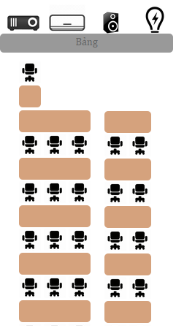

ROOM TYPE

Slide 35
ROOM TYPE
ROOMTYPE OBJECT
RoomTypeID
Name
VerticalRows

Slide 36
ROOM TYPE
ROOMTYPE OBJECT
RoomTypeID
Name
VerticalRows
HorizontalRows

Slide 37
ROOM TYPE
ROOMTYPE OBJECT
RoomTypeID
Name
VerticalRows
HorizontalRows
NumberOfSlotsEachHRows

Slide 38
ROOM TYPE
ROOMTYPE OBJECT
RoomTypeID
Name
VerticalRows
HorizontalRows
NumberOfSlotsEachHRows
1..1
0..*
EQUIPMENT QUANTITY OBJECT
RoomTypeID
EquipmentName

Slide 39
SCHEDULE
Update equipment using time
Why need schedule ?

Slide 40
SCHEDULE
Update equipment using time
Why need schedule ?
Find available room when needed

Slide 41
SCHEDULE
Update equipment using time
Why need schedule ?
Find available room when needed
Check report of user

Slide 42
SCHEDULE
SCHEDULE OBJECT
Username
ClassName
ScheduleConfigID
Date
SCHEDULE CONFIG OBJECT
Slot
TimeFrom
TimeTo
0..*
1..1

Slide 43

REPORT DAMAGED EQUIPMENT

Slide 44
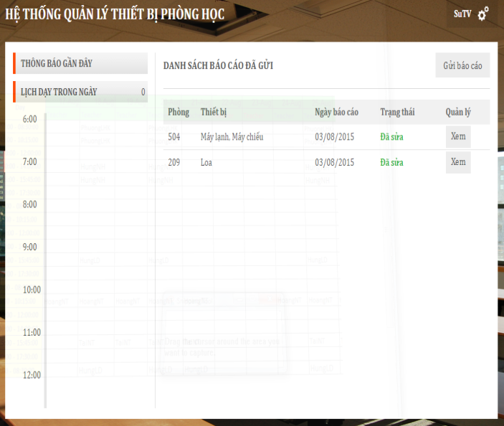
REPORT DAMAGED EQUIPMENT

Slide 45

REPORT DAMAGED EQUIPMENT

Slide 46
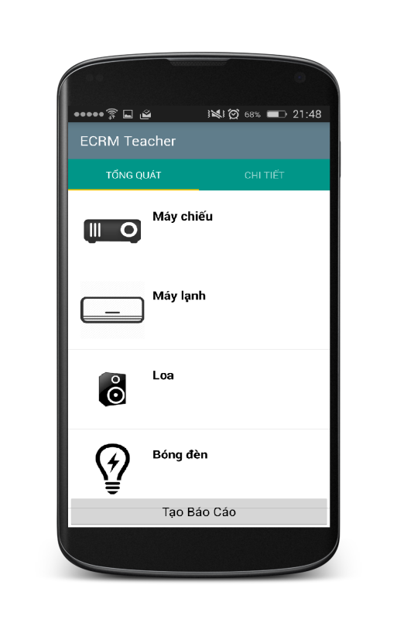
REPORT DAMAGED EQUIPMENT
Step 1:
Choose damaged equipment and evaluate

Slide 47

REPORT DAMAGED EQUIPMENT
Step 2:
Send report to server

Slide 48
REPORT DAMAGED EQUIPMENT
REPORT OBJECT
Username
ClassName
Evaluate
Date
1..1
0..*
REPORT DETAIL OBJECT
EquipmentName
DamageLevel
Evaluate

Slide 49
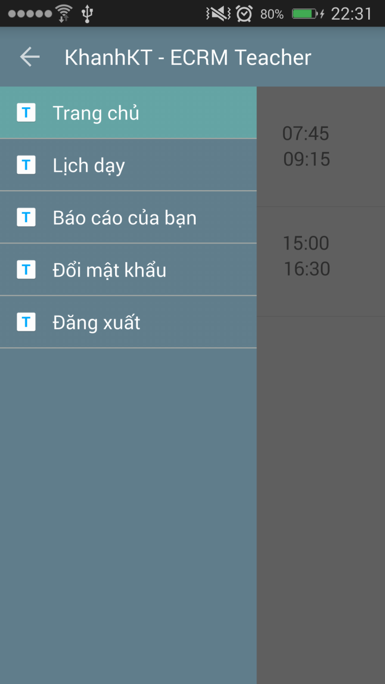
REPORT DAMAGED EQUIPMENT
REPORT OBJECT
Username
ClassName
Evaluate
Date
1..1
0..*
REPORT DETAIL OBJECT
EquipmentName
DamageLevel
Evaluate

Slide 50
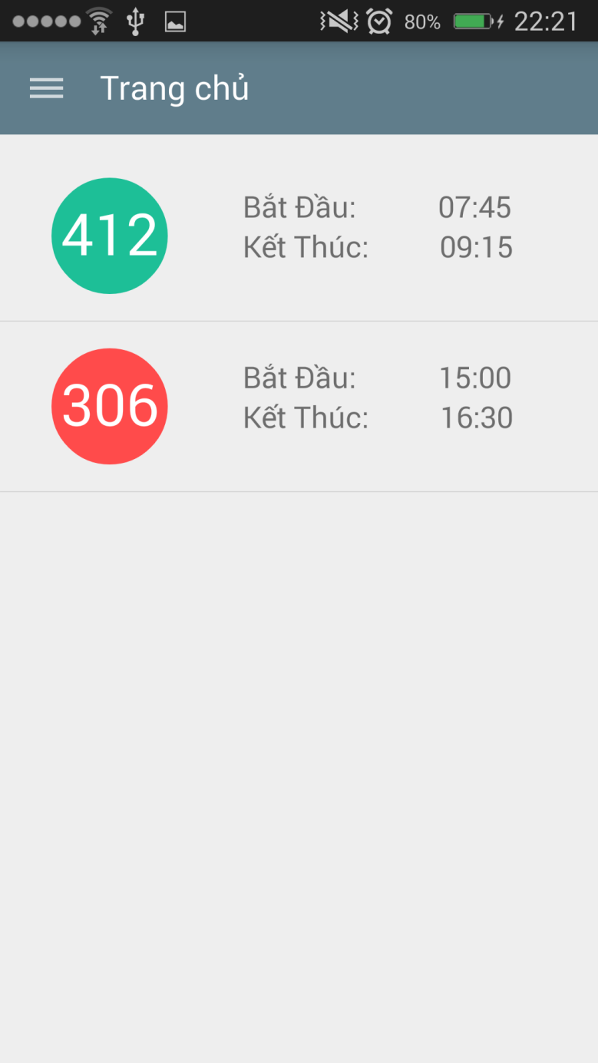
REPORT DAMAGED EQUIPMENT
REPORT OBJECT
Username
ClassName
Evaluate
Date
1..1
0..*
REPORT DETAIL OBJECT
EquipmentName
DamageLevel
Evaluate

Slide 51
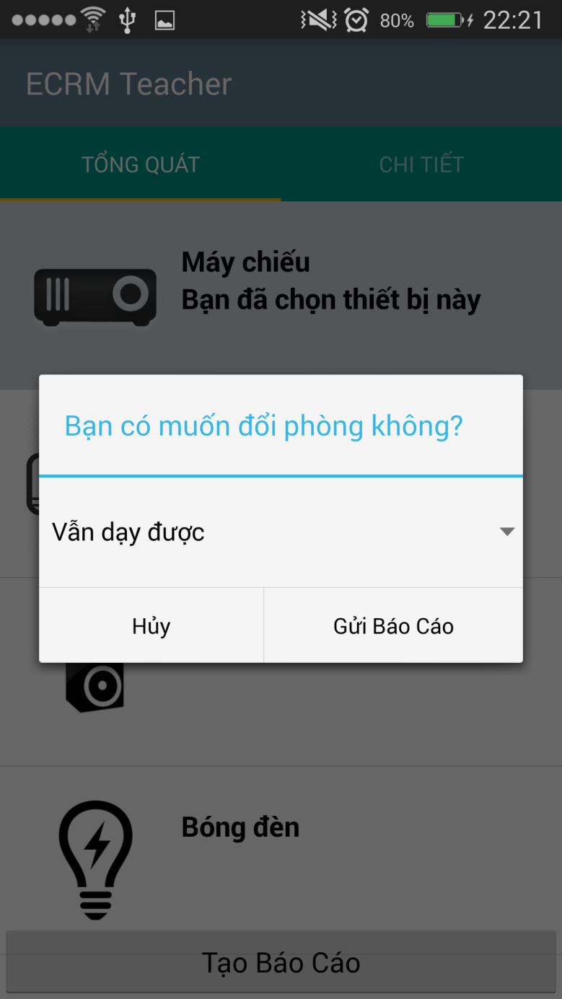
REPORT DAMAGED EQUIPMENT
REPORT OBJECT
Username
ClassName
Evaluate
Date
1..1
0..*
REPORT DETAIL OBJECT
EquipmentName
DamageLevel
Evaluate

Slide 52
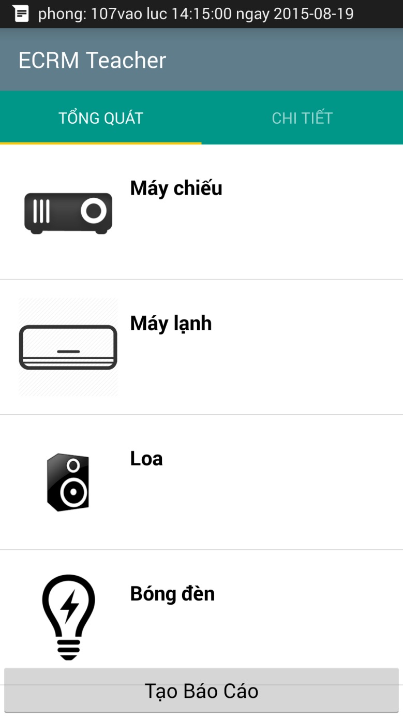
REPORT DAMAGED EQUIPMENT
REPORT OBJECT
Username
ClassName
Evaluate
Date
1..1
0..*
REPORT DETAIL OBJECT
EquipmentName
DamageLevel
Evaluate

Slide 53
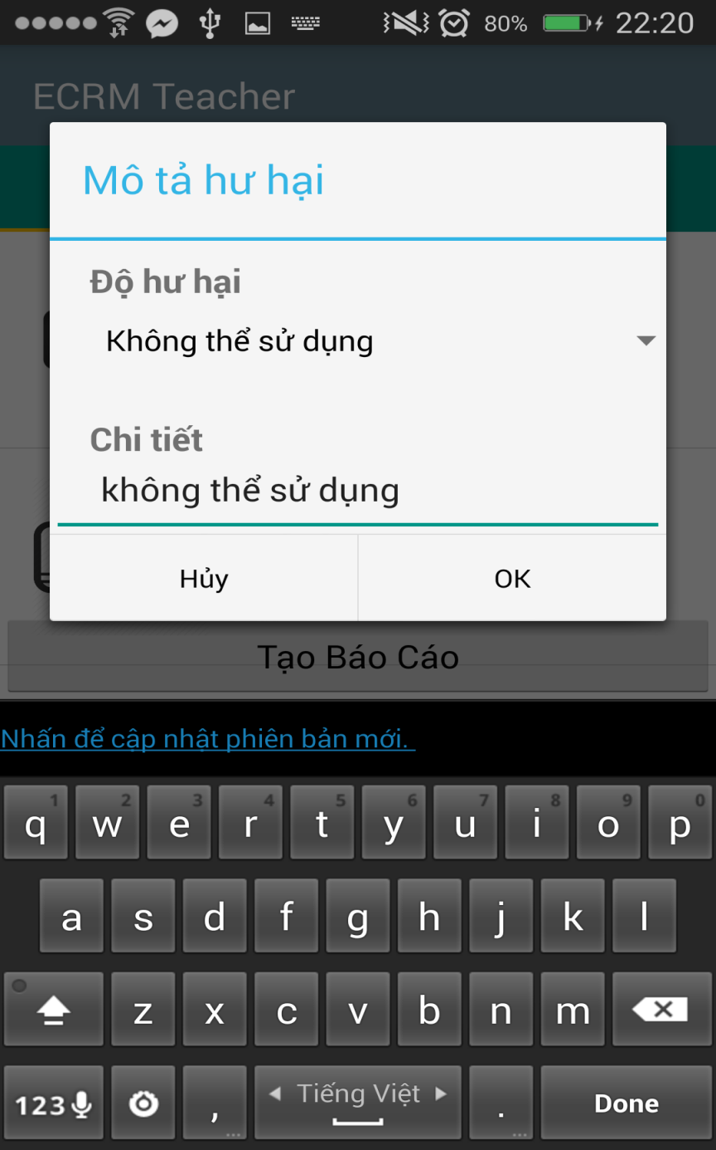
REPORT DAMAGED EQUIPMENT
REPORT OBJECT
Username
ClassName
Evaluate
Date
1..1
0..*
REPORT DETAIL OBJECT
EquipmentName
DamageLevel
Evaluate

Slide 54
REPORT DAMAGED EQUIPMENT
REPORT OBJECT
Username
ClassName
Evaluate
Date
1..1
0..*
REPORT DETAIL OBJECT
EquipmentName
DamageLevel
Evaluate

Slide 55

REPORT DAMAGED EQUIPMENT
Step 3:
Save data to database

Slide 56
REPORT DAMAGED EQUIPMENT
Step 4:
Notify to staff

Slide 57

REPORT DAMAGED EQUIPMENT
Step 5:
Analyze data from report

Slide 58
REPORT DAMAGED EQUIPMENT
Step 6:
Send notification to teacher

Slide 59

REPORT DAMAGED EQUIPMENT
Step 7:
Send notification to another teacher

Slide 60
ANALYZE DATA AND MAKING DECISION

Slide 61
ANALYZE DATA AND MAKING DECISION
REPORT OBJECT
Username
ClassName
Evaluate
Date
1..1
0..*
REPORT DETAIL OBJECT
EquipmentName
DamageLevel
Evaluate

Slide 62
ANALYZE DATA AND MAKING DECISION
REPORT OBJECT
Username
ClassName
Evaluate
Date
ROOM TYPE OBJECT
NoSlots
List Equipments
List Equipment’s Priority
1..1
0..*
REPORT DETAIL OBJECT
EquipmentName
DamageLevel
Evaluate

Slide 63

ANALYZE DATA AND MAKING DECISION

Slide 64
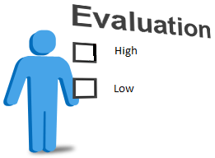
ANALYZE DATA AND MAKING DECISION

Slide 65

ANALYZE DATA AND MAKING DECISION
High
Medium
Low

Slide 66
ANALYZE DATA AND MAKING DECISION
High
Medium
Low
Damaged level

Slide 67

ANALYZE DATA AND MAKING DECISION
REPORT

Slide 68
ANALYZE DATA AND MAKING DECISION
REPORT
ROOM TYPE

Slide 69
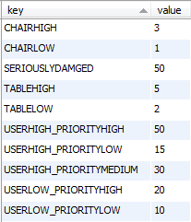
ANALYZE DATA AND MAKING DECISION
REPORT
Step 1:
Analyze data
Evaluate is “Không thể sử dụng”
CONFIGURATION
ROOM TYPE
Priority is “Cao”

Slide 70
ANALYZE DATA AND MAKING DECISION
REPORT
Step 1:
Analyze data
50
CONFIGURATION
ROOM TYPE

Slide 71
ANALYZE DATA AND MAKING DECISION
REPORT
Step 1:
Analyze data
50
CONFIGURATION
Evaluate is “Có thể sử dụng”
ROOM TYPE
Priority is “Thấp”

Slide 72
ANALYZE DATA AND MAKING DECISION
REPORT
Step 1:
Analyze data
50
CONFIGURATION
10
ROOM TYPE

Slide 73
ANALYZE DATA AND MAKING DECISION
REPORT
50
CONFIGURATION
10
ROOM TYPE
60

Slide 74
ANALYZE DATA AND MAKING DECISION
Step 2:
Making decision

Slide 75
ANALYZE DATA AND MAKING DECISION
Step 2:
Making decision
CONFIGURATION
Get seriously damage in database

Slide 76
ANALYZE DATA AND MAKING DECISION
Step 2:
Making decision
Get seriously damage in database
Is damage level larger than seriously damage ?

Slide 77
ANALYZE DATA AND MAKING DECISION
Step 2:
Making decision
Get seriously damage in database
Is damage level larger than seriously damage ?
NO
YES
Find available room and change room
Update damage for classroom. Finish.

Slide 78
FIND AVAILABLE ROOM

Slide 79
FIND AVAILABLE ROOM
Class Name: 302
Room Type: “Thông Dụng” with 30 slots, 2 air conditioner,

Slide 80
FIND AVAILABLE ROOM
Step 1:
Get undamaged classrooms
202
303
201
301
402
101
503
List undamaged classrooms

Slide 81
FIND AVAILABLE ROOM
Step 2:
Sort by floor
Class Name: 302
202
303
201
301
402
101
503
List undamaged classrooms

Slide 82
FIND AVAILABLE ROOM
Step 2:
Sort by floor
Class Name: 302
Sort
202
303
201
301
402
101
503
301
List undamaged classrooms

Slide 83
FIND AVAILABLE ROOM
Step 2:
Sort by floor
Class Name: 302
Sort
202
303
201
301
402
101
503
301
303
List undamaged classrooms

Slide 84
FIND AVAILABLE ROOM
Step 2:
Sort by floor
Class Name: 302
Sort
202
303
201
301
402
101
503
301
303
201
List undamaged classrooms

Slide 85
FIND AVAILABLE ROOM
Step 2:
Sort by floor
Class Name: 302
Sort
202
303
201
301
402
101
503
301
303
201
202
List undamaged classrooms

Slide 86
FIND AVAILABLE ROOM
Step 2:
Sort by floor
Class Name: 302
Sort
202
303
201
301
402
101
503
301
303
201
202
402
List undamaged classrooms

Slide 87
FIND AVAILABLE ROOM
Step 2:
Sort by floor
Class Name: 302
Sort
202
303
201
301
402
101
503
301
303
201
202
402
101
List undamaged classrooms

Slide 88
FIND AVAILABLE ROOM
Step 2:
Sort by floor
Class Name: 302
Sort
202
303
201
301
402
101
503
301
303
201
202
402
101
503
List undamaged classrooms
List sort by floor

Slide 89
FIND AVAILABLE ROOM
Step 3:
Compare with room type
Room Type: “Thông Dụng” with 30 slots, 2 air conditioner,…
301
303
201
202
402
101
503
List sort by floor

Slide 90
FIND AVAILABLE ROOM
Step 3:
Compare with room type
Room Type: “Thông Dụng” with 30 slots, 2 air conditioner,…
Compare
301
303
201
202
402
101
503
301
303
201
202
402
101
503
List sort by floor
Room Type is “Thông Dụng”

Slide 91
FIND AVAILABLE ROOM
Step 3:
Compare with room type
Room Type: “Thông Dụng” with 30 slots, 2 air conditioner,…
Compare
301
303
201
202
402
101
503
503
301
303
201
202
402
101
List sort by floor
Room Type is “Thông Dụng”

Slide 92
FIND AVAILABLE ROOM
Step 3:
Compare with room type
Room Type: “Thông Dụng” with 30 slots, 2 air conditioner,…
Compare
301
303
201
202
402
101
503
503
301
303
201
202
402
101
List sort by floor
Room Type is smaller than current Room Type

Slide 93
FIND AVAILABLE ROOM
Step 3:
Compare with room type
Room Type: “Thông Dụng” with 30 slots, 2 air conditioner,…
Compare
301
303
201
202
402
101
503
402
503
301
303
201
202
101
List sort by floor
Room Type is equal current Room Type

Slide 94
FIND AVAILABLE ROOM
Step 3:
Compare with room type
Room Type: “Thông Dụng” with 30 slots, 2 air conditioner,…
Compare
301
303
201
202
402
101
503
202
402
503
301
303
201
101
List sort by floor
Room Type is larger current Room Type

Slide 95
FIND AVAILABLE ROOM
Step 3:
Compare with room type
Room Type: “Thông Dụng” with 30 slots, 2 air conditioner,…
Compare
301
303
201
202
402
101
503
202
402
503
301
303
201
101
List sort by floor
Room Type is smaller than current Room Type

Slide 96
FIND AVAILABLE ROOM
Step 3:
Compare with room type
Room Type: “Thông Dụng” with 30 slots, 2 air conditioner,…
Compare
301
303
201
202
402
101
503
202
402
503
301
303
201
101
List sort by floor
Room Type is smaller than current Room Type

Slide 97
FIND AVAILABLE ROOM
Step 3:
Compare with room type
Room Type: “Thông Dụng” with 30 slots, 2 air conditioner,…
Compare
301
303
201
202
402
101
503
202
402
503
301
303
201
101
List sort by floor
Room Type is smaller than current Room Type

Slide 98
FIND AVAILABLE ROOM
Step 3:
Compare with room type
Room Type: “Thông Dụng” with 30 slots, 2 air conditioner,…
Compare
301
303
201
202
402
101
503
202
402
503
301
303
201
101
List sort by floor
List after compare

Slide 99
FIND AVAILABLE ROOM
Class Name: 302
Room Type: “Thông Dụng” with 30 slots, 2 air conditioner…
202
402
503
301
303
201
101
202
Result
List after compare

Slide 100
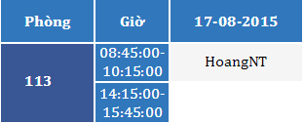

SCENARIO PROBLEM 1
Mr. HoangNT

Slide 101
SCENARIO PROBLEM 1
17-08-2015
09:00 AM
Classroom 113
Projector: “Không thể sử dụng được”
Air conditioning: “Không thể sử dụng được”
Mr. HoangNT

Slide 102
SCENARIO PROBLEM 1
17-08-2015
09:00 AM
Classroom 113
Projector: “Không thể sử dụng được”
Air conditioning: “Không thể sử dụng được”
Mr. HoangNT
Classroom 113
Damaged Level: 80%
IsDamaged: true

Slide 103

SCENARIO PROBLEM 1
17-08-2015
09:00 AM
Classroom 113
Projector: “Không thể sử dụng được”
Air conditioning: “Không thể sử dụng được”
Mr. HoangNT
Classroom 113
Damaged Level: 80%
IsDamaged: true

Slide 104
SCENARIO PROBLEM 1
17-08-2015
09:00 AM
Classroom 113
Projector: “Không thể sử dụng được”
Air conditioning: “Không thể sử dụng được”
Mr. HoangNT
Analyze data
Classroom 113
Damaged Level: 80%
IsDamaged: true

Slide 105
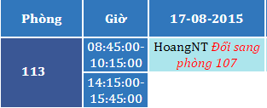
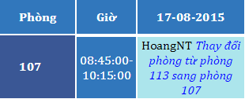
SCENARIO PROBLEM 1
17-08-2015
09:00 AM
Classroom 113
Projector: “Không thể sử dụng được”
Air conditioning: “Không thể sử dụng được”
Mr. HoangNT
Analyze data
Classroom 113
Damaged Level: 80%
IsDamaged: true

Slide 106
SCENARIO PROBLEM 1
17-08-2015
09:00 AM
Classroom 113
Projector: “Không thể sử dụng được”
Air conditioning: “Không thể sử dụng được”
Mr. HoangNT
Analyze data
Classroom 113
Damaged Level: 80%
IsDamaged: true

Slide 107
SCENARIO PROBLEM 1
17-08-2015
09:00 AM
Classroom 113
Projector: “Không thể sử dụng được”
Air conditioning: “Không thể sử dụng được”
Mr. HoangNT
18-08-2015
06:30 AM
Classroom 113
Damaged Level: 80%
IsDamaged: true

Slide 108
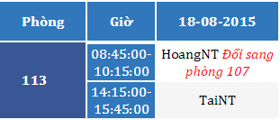
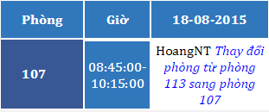
SCENARIO PROBLEM 1
17-08-2015
09:00 AM
Classroom 113
Projector: “Không thể sử dụng được”
Air conditioning: “Không thể sử dụng được”
Mr. HoangNT
18-08-2015
06:30 AM
Classroom 113
Damaged Level: 80%
IsDamaged: true

Slide 109
SCENARIO PROBLEM 1
17-08-2015
09:00 AM
Classroom 113
Projector: “Không thể sử dụng được”
Air conditioning: “Không thể sử dụng được”
Mr. HoangNT
18-08-2015
06:30 AM
Classroom 113
Damaged Level: 80%
IsDamaged: true

Slide 110
CHECK STATUS OF CLASSROOM
Time:
06:30 AM - 12:15 PM Every day
Actor:
System
Goal:
Checking current status of classroom
Make decision when needed

Slide 111
CHECK STATUS OF CLASSROOM
Step 1
Get all classrooms are damaged

Slide 112
CHECK STATUS OF CLASSROOM
Step 1
Get all classrooms are damaged
Step 2
Find available room to change

Slide 113
CHECK STATUS OF CLASSROOM
Step 1
Get all classrooms are damaged
Step 2
Find available room to change
Step 3
Change room and notice to teacher

Slide 114
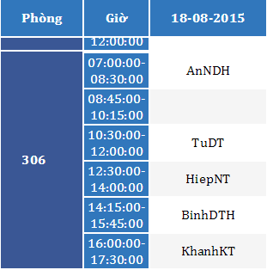
SCENARIO PROBLEM 2
Mr. AnNDH

Slide 115
SCENARIO PROBLEM 2
18-08-2015
08:15 AM
306
Projector: “Không thể sử dụng được”
Mr. AnNDH

Slide 116
SCENARIO PROBLEM 2
18-08-2015
08:15 AM
306
Projector: “Không thể sử dụng được”
Mr. AnNDH
Classroom 306
Damaged Level: 50%
IsDamaged: true

Slide 117
SCENARIO PROBLEM 2
18-08-2015
08:15 AM
306
Projector: “Không thể sử dụng được”
Mr. AnNDH
Classroom 306
Damaged Level: 50%
IsDamaged: true

Slide 118
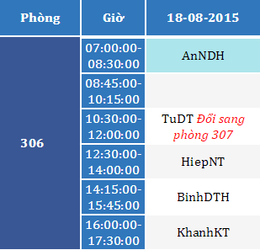
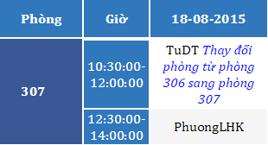
SCENARIO PROBLEM 2
18-08-2015
08:15 AM
306
Projector: “Không thể sử dụng được”
Mr. AnNDH
Classroom 306
Damaged Level: 50%
IsDamaged: true
Analyze data

Slide 119
SCENARIO PROBLEM 2
18-08-2015
08:15 AM
306
Projector: “Không thể sử dụng được”
Mr. AnNDH
Classroom 306
Damaged Level: 50%
IsDamaged: true
Analyze data

Slide 120
SCENARIO PROBLEM 2
18-08-2015
08:15 AM
306
Projector: “Không thể sử dụng được”
Mr. AnNDH
18-08-2015
12:15 PM
Classroom 306
Damaged Level: 50%
IsDamaged: true

Slide 121
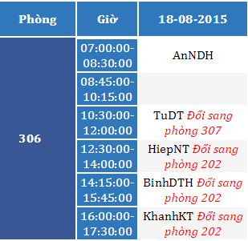
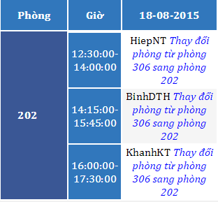
SCENARIO PROBLEM 2
18-08-2015
08:15 AM
306
Projector: “Không thể sử dụng được”
Mr. AnNDH
18-08-2015
12:15 PM
Classroom 306
Damaged Level: 50%
IsDamaged: true

Slide 122
SCENARIO PROBLEM 2
18-08-2015
08:15 AM
306
Projector: “Không thể sử dụng được”
Mr. AnNDH
18-08-2015
12:15 PM
Classroom 306
Damaged Level: 50%
IsDamaged: true

Slide 123
SCENARIO PROBLEM 2
18-08-2015
08:15 AM
306
Projector: “Không thể sử dụng được”
Mr. AnNDH
19-08-2015
06:30 AM
Classroom 306
Damaged Level: 50%
IsDamaged: true

Slide 124
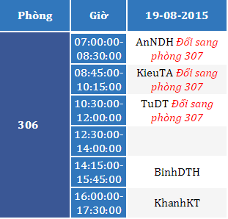
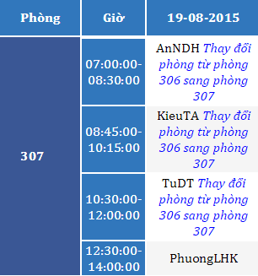
SCENARIO PROBLEM 2
18-08-2015
08:15 AM
306
Projector: “Không thể sử dụng được”
Mr. AnNDH
19-08-2015
06:30 AM
Classroom 306
Damaged Level: 50%
IsDamaged: true

Slide 125
SCENARIO PROBLEM 2
18-08-2015
08:15 AM
306
Projector: “Không thể sử dụng được”
Mr. AnNDH
19-08-2015
06:30 AM
Classroom 306
Damaged Level: 50%
IsDamaged: true

Slide 126
SCENARIO PROBLEM 3
Classroom 113
Damaged Level: 80%
IsDamaged: true
Classroom 306
Damaged Level: 50%
IsDamaged: true

Slide 127
SCENARIO PROBLEM 3
Classroom 113
Damaged Level: 80%
IsDamaged: true
Classroom 306
Damaged Level: 50%
IsDamaged: true
306
Resolve

Slide 128
SCENARIO PROBLEM 3
Classroom 113
Damaged Level: 80%
IsDamaged: true
Classroom 306
Damaged Level: 50%
IsDamaged: true
306
Resolve
Classroom 306
Damaged Level: 0%
IsDamaged: false

Slide 129
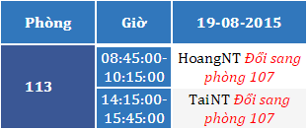
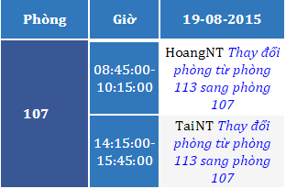
SCENARIO PROBLEM 3
Classroom 113
Damaged Level: 80%
IsDamaged: true
Classroom 306
Damaged Level: 50%
IsDamaged: true
306
Resolve
Classroom 306
Damaged Level: 0%
IsDamaged: false
19-08-2015 12:15 PM

Slide 130
SCENARIO PROBLEM 3
Classroom 113
Damaged Level: 80%
IsDamaged: true
Classroom 306
Damaged Level: 50%
IsDamaged: true
306
Resolve
Classroom 306
Damaged Level: 0%
IsDamaged: false
19-08-2015 12:15 PM

Slide 131
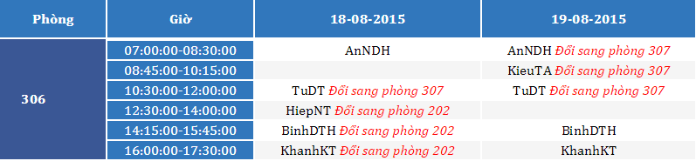
SCENARIO PROBLEM 3
Classroom 113
Damaged Level: 80%
IsDamaged: true
Classroom 306
Damaged Level: 50%
IsDamaged: true
306
Resolve
Classroom 306
Damaged Level: 0%
IsDamaged: false
19-08-2015 12:15 PM
Back to classroom 306

Slide 132
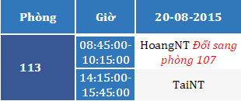
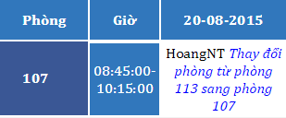
SCENARIO PROBLEM 3
Classroom 113
Damaged Level: 80%
IsDamaged: true
Classroom 306
Damaged Level: 50%
IsDamaged: true
306
Resolve
Classroom 306
Damaged Level: 0%
IsDamaged: false
20-08-2015 06:30 AM

Slide 133
SCENARIO PROBLEM 3
Classroom 113
Damaged Level: 80%
IsDamaged: true
Classroom 306
Damaged Level: 50%
IsDamaged: true
306
Resolve
Classroom 306
Damaged Level: 0%
IsDamaged: false
20-08-2015 06:30 AM

Slide 134
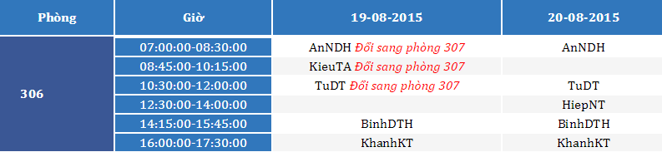
SCENARIO PROBLEM 3
Classroom 113
Damaged Level: 80%
IsDamaged: true
Classroom 306
Damaged Level: 50%
IsDamaged: true
306
Resolve
Classroom 306
Damaged Level: 0%
IsDamaged: false
20-08-2015 06:30 AM
Back to classroom 306

Slide 135
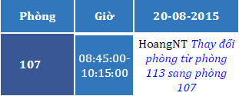
SCENARIO PROBLEM 3
Mr. HoangNT

Slide 136
SCENARIO PROBLEM 3
20-08-2015
09:00 AM
107
Projector: “Không thể sử dụng được”
Speaker: “Không thể sử dụng được”
Mr. HoangNT

Slide 137
SCENARIO PROBLEM 3
20-08-2015
09:00 AM
107
Projector: “Không thể sử dụng được”
Speaker: “Không thể sử dụng được”
Mr. HoangNT
Classroom 107
Damaged Level: 80%
IsDamaged: true

Slide 138
SCENARIO PROBLEM 3
20-08-2015
09:00 AM
107
Projector: “Không thể sử dụng được”
Speaker: “Không thể sử dụng được”
Mr. HoangNT
Classroom 107
Damaged Level: 80%
IsDamaged: true

Slide 139
SCENARIO PROBLEM 3
20-08-2015
09:00 AM
107
Projector: “Không thể sử dụng được”
Speaker: “Không thể sử dụng được”
Mr. HoangNT
Analyze data
Classroom 107
Damaged Level: 80%
IsDamaged: true

Slide 140

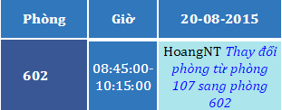
SCENARIO PROBLEM 3
20-08-2015
09:00 AM
107
Projector: “Không thể sử dụng được”
Speaker: “Không thể sử dụng được”
Mr. HoangNT
Analyze data
Classroom 107
Damaged Level: 80%
IsDamaged: true

Slide 141
SCENARIO PROBLEM 3
20-08-2015
09:00 AM
107
Projector: “Không thể sử dụng được”
Speaker: “Không thể sử dụng được”
Mr. HoangNT
Analyze data
Classroom 107
Damaged Level: 80%
IsDamaged: true

Slide 142
SCENARIO PROBLEM 3
113
Resolve

Slide 143
SCENARIO PROBLEM 3
113
Resolve
Classroom 113
Damaged Level: 0%
IsDamaged: false

Slide 144

SCENARIO PROBLEM 3
113
Resolve
Classroom 113
Damaged Level: 0%
IsDamaged: false
21-08-2015 06:30 AM
Back to classroom 113

Slide 145
SCENARIO PROBLEM 3
113
Resolve
Classroom 113
Damaged Level: 0%
IsDamaged: false
21-08-2015 06:30 AM
Back to classroom 113

Slide 146
ADVANTAGE & DISADVANTAGE
Advantage
Require less human source
Save time when receive and resolve report
Easy to check status of equipment, classroom
User interface is friendly, easy to use.
Disadvantage
Can not check user behavior.
Only support for Android OS.

Slide 147
FUTURE PLAN
Synchronize schedule with Google Calendar
Support other mobile OS

Slide 148
Question and Answer

